Slide 1
Static and Friend
Notes:
over.

Slide 2
Static

Slide 3
Student ”using static”
class student
{
int id;
string name;
public:
static int st_num;
student(int id, string name)
{
st_num++;
this->id= id;
this->name= name;
}
};
int student :: st_num=0;
void main()
{
student s1( 1, “ali”);
cout<< student:: st_num <<endl;
student s2 ( 5 , “ahmed”);
cout<< student:: st_num <<endl;
student s3( 3, “mohamed”);
cout<< student:: st_num <<endl;
}

Slide 4
Student ”using static” (cont.)
class student
{
int id;
string name;
static int st_num;
public:
student(int id, string name)
{
st_num++;
this->id= id;
this->name= name;
}
static int getStNum()
{
return st_num;
}
}; // end of student class
int student :: st_num=0;
void main()
{
student s1( 1, “ali”);
cout<< student:: getStNum() <<endl;
student s2( 2 , “ahmed”);
cout<< student:: getStNum() <<endl;
student s3( 3, “mohamed”);
cout<< student:: getStNum() <<endl;
}

Slide 5
Exercise 1
A corporation has three divisions, each responsible for sales to different geographic locations. Design a DivSales class that keeps sales data for a division, with the following data members:
first_half, second_half, and static variable total_sales
The class also contains the following member functions:
A member function that takes two arguments, each assumed to be the sales for a half. The value of the arguments should be copied into the variables hold the sales data. The total of the two arguments should be added to the static variable that holds the total yearly corporate sales.
Write a program that creates an array of three DivSales objects. The program should ask the user to enter the sales for the two half for each division. After the data are entered, the program should display a table showing the division sales for each half. The program should then display the total corporate sales for the year.

Slide 7
Friend Function
A friend is a way to contain similar methods and ideas that are outside the scope of the original class, but are reliant on that class’ data.
The declaration of friend function should be made inside the body of class (can be anywhere inside class either in private or public section) starting with keyword friend.

Slide 8
Example ”Single friend function”
class Battery{
int minPER, recentPER, temp;
public:
Battery( int minPER , int recentPER)
{
temp= 20;
this-> minPER = minPER;
this-> recentPER = recentPER;
}
// do set and get for minPER, recentPER
friend void swapEmergency(Battery&);
};
void swapEmergency(Battery & s1)
{
if( s1.recentPER < s1.minPER )
s1.recentPER = s1.temp;
}
void main()
{
Battery b1;
swapEmergency ( b1 );
cout << b1.getRecentPER( ) ;
}

Slide 9
Friend Function
Non-member function.
Have access to private members of a class.
Friend to more than one class.
Class gives the permission of friend not the function.

Slide 10
Why do we use friend ?

Slide 11
Example ”using member function”
class square
{
int side;
public:
square(int a)
{
side = a;
}
int sArea()
{
return ( side * side );
}
};
class rect
{
int width, height;
public:
rect (int a, int b)
{
width = a;
height = b;
}
int rArea()
{
return ( width * height );
}
};

Slide 12
Example (cont.)
int addArea (square s, rect r)
{
return ( s.sArea() + r.rArea() );
}
void main()
{
square sq(5);
rect rec(3,5);
cout << addArea( sq , rec) <<endl;
}

Slide 13
Example ”using set & get”
class square
{
int side;
public:
square(int a)
{
side = a;
}
int getSide()
{
return side;
}
};
class rect
{
int width, height;
public:
rect (int a, int b)
{
width = a;
height = b;
}
int getWidth() { return width; }
int getHeight() { return height; }
};

Slide 14
Example ”using set & get” (cont.)
int addArea (square s, rect r)
{
return ( s.getSide() * s.getSide() + r.getWidth() * r.getHeight() );
}
void main()
{
square sq(5);
rect rec(3,5);
cout << addArea( sq , rec) <<endl;
}

Slide 15
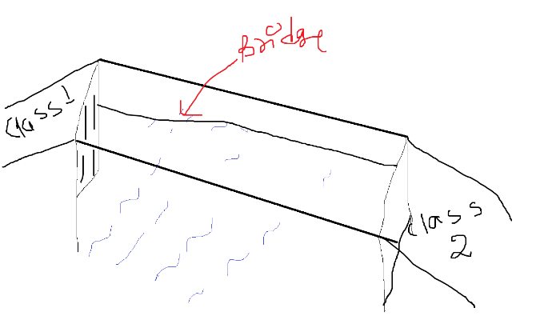
Friend Function
This situation arises mostly in case of operator overloading.
When you want to compare two private data members of two different classes. In that case you create a normal function and make friend in both the classes, as to provide access of theirs private variables.

Slide 16
Example ”using multiple friend”
class square
{
int side;
public:
square(int a)
{
side = a;
}
friend int addArea(square s, rect r);
};
class rect
{
int width, height;
public:
rect (int a, int b)
{
width = a;
height = b;
}
friend int addArea(square s, rect r);
};
class rect;

Slide 17
Example ”using multiple friend” (cont.)
int addArea (square s, rect r)
{
return ( s.side * s.side + r.width * r.height );
}
void main()
{
square sq(5);
rect rec(3,5);
cout << addArea( sq , rec) <<endl;
}

Slide 18
Exercises 2
Use operator overloading instead of addArea.
friend int operator+ (square s, rect r)

Slide 19
Exercises 3
Find the largest area of rectangle or square and print it using friend function.
friend void largest (square s, rect r)

Slide 20
Friend Class
class Storage
{
private:
double m_dValue;
public:
Storage(double dValue)
{
m_dValue = dValue;
}
friend class Display;
};
class Display
{
private:
bool m_display;
public:
Display(bool display) { m_display = display; }
void displayItem(Storage storage)
{
if(m_display)
cout << storage.m_dValue << endl;
}
};
void main()
{
Storage st(5, 6.7);
Display dis(true);
dis.displayItem(st);
}

